Slide 1
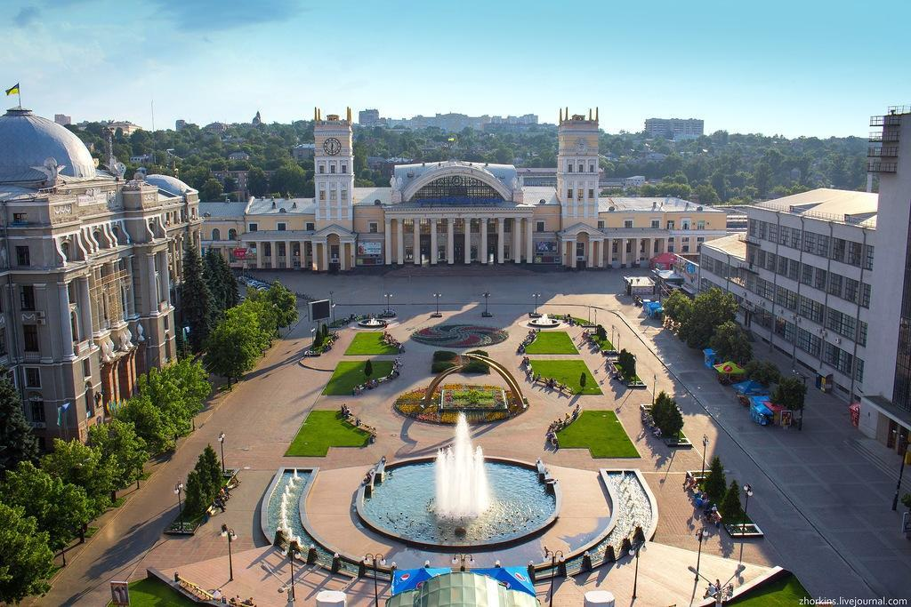
Kharkiv

Slide 2
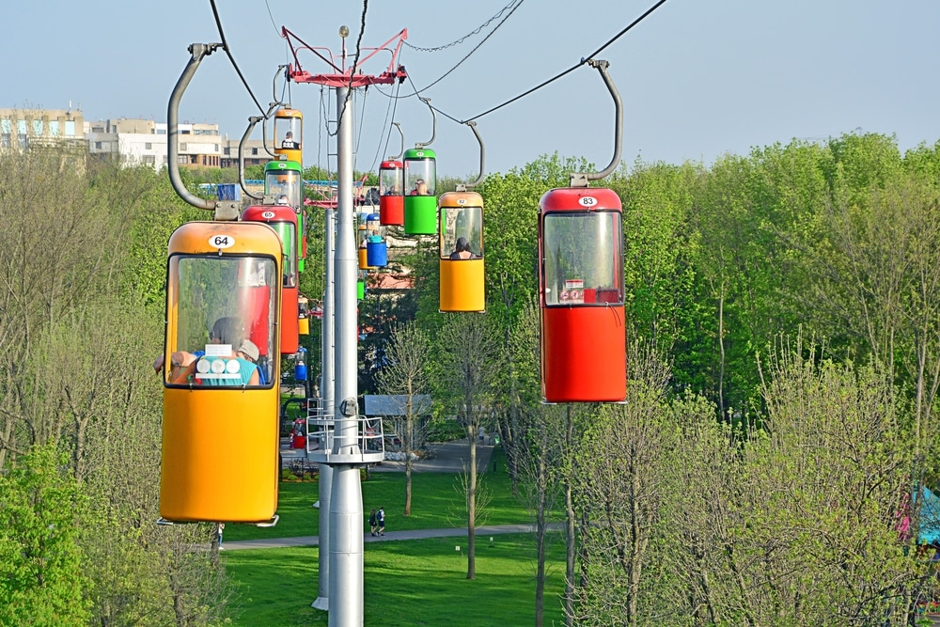
Maxim Gorky Park

Slide 3
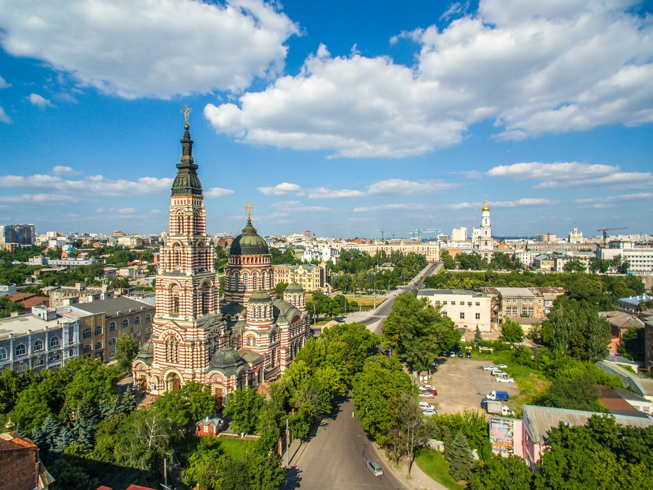
Annunciation Cathedral

Slide 4
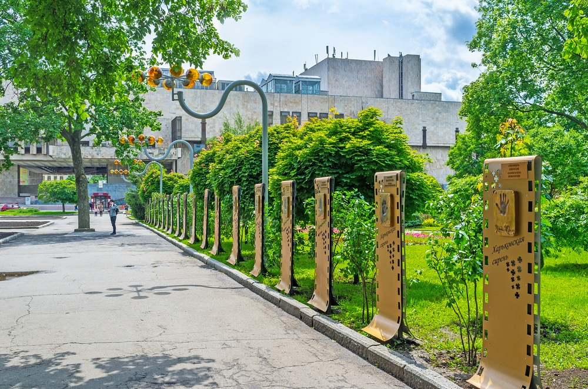
Taras Shevchenko Garden

Slide 5
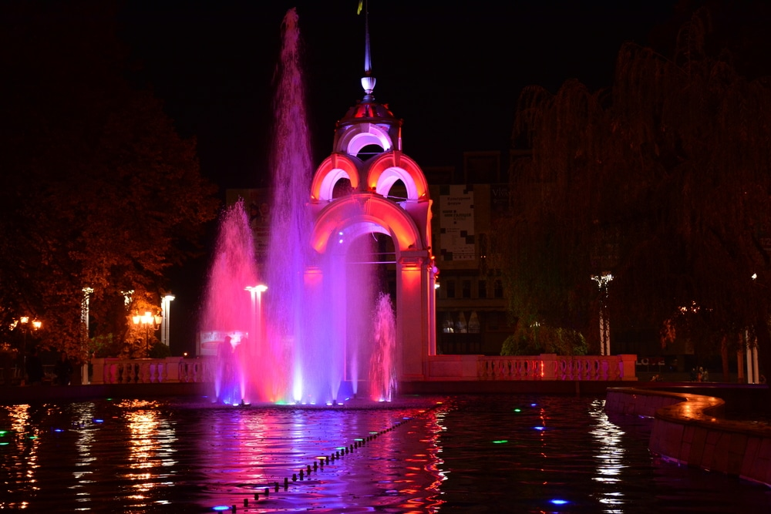
Mirror Stream Fountain

Slide 6
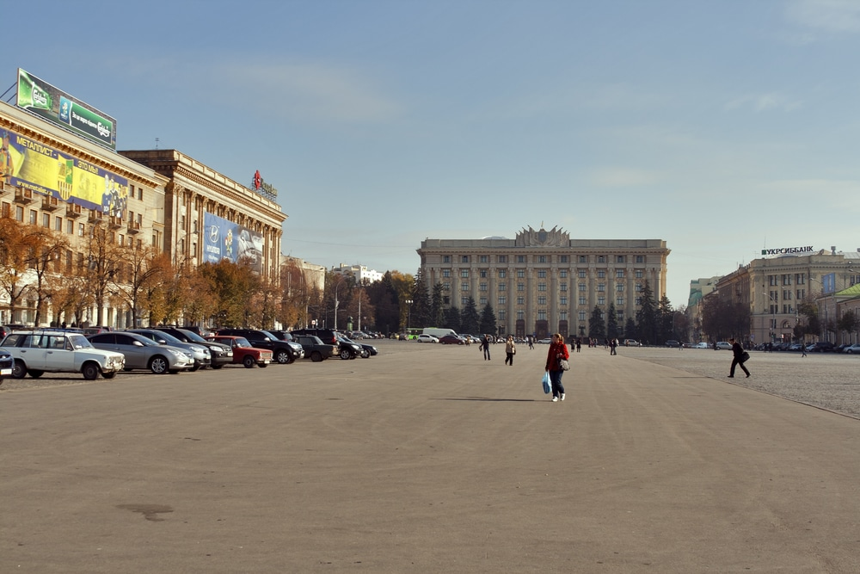
Freedom Square

Slide 7
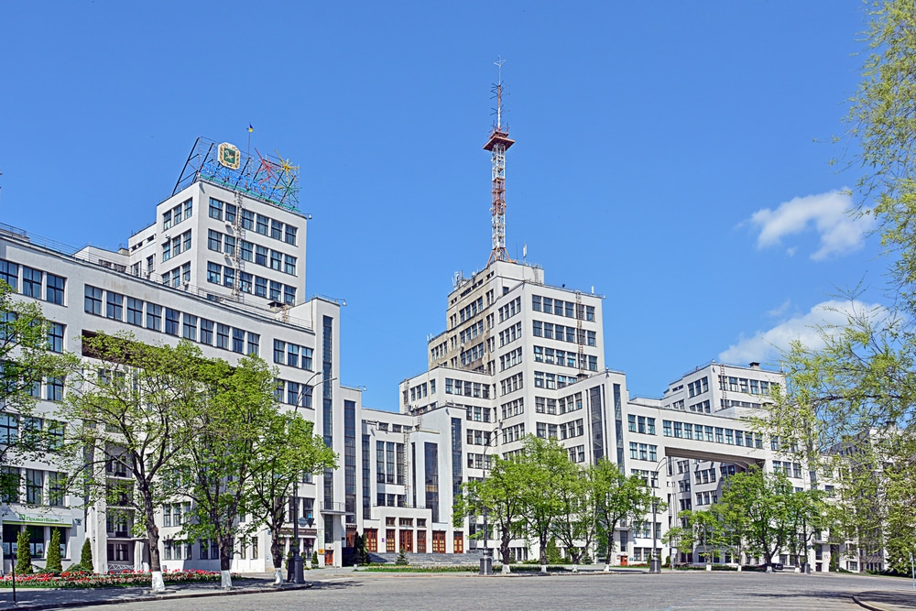
Derzhprom

Slide 8
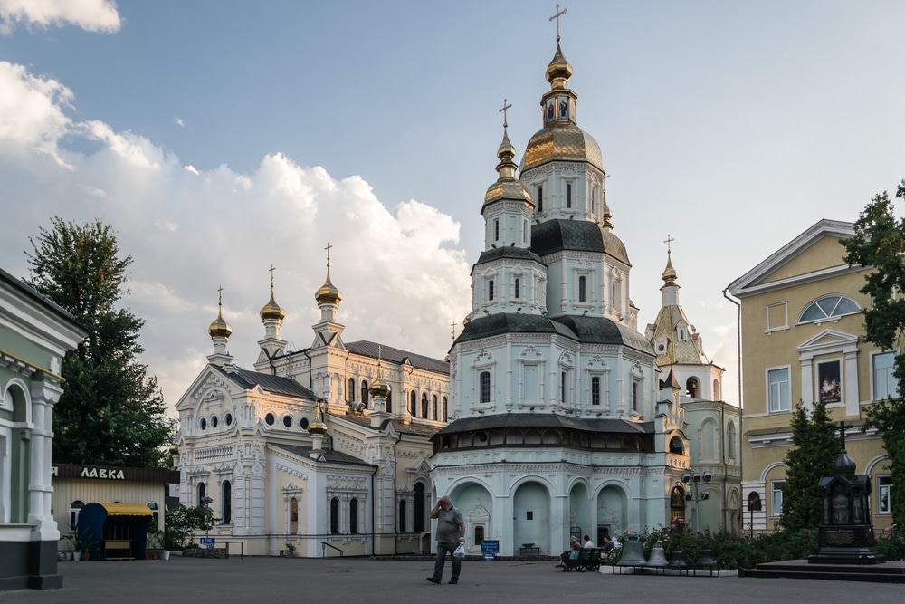
Pokrovsky Cathedral

Slide 9
My home town is Kharkiv. It is one of the largest cities in Ukraine. The population of the city is over 1,440,000 citizens. Kharkiv is a beautiful, picturesque city located in the North-East of Ukraine. (500 kilometres from Kyiv, the capital of Ukraine.) Kharkiv is the former capital of Ukraine. The main rivers of Kharkiv are the Kharkiv, the Lopan, the Udy and there are also some small rivers. The climate in Kharkiv is moderately continental, with moderately mild winters and long, hot, sometimes dry summers.Average annual temperature is 8 °C. The city is divided into nine districts. Modern Kharkiv was founded in the seventeenth century.In the centre of the city there is a beautiful garden, which bears the name of Taras Shevchenko. Near it you can see Freedom Square, one of the largest squares in Europe. All city celebrations are usually held here. There is also a new building of the Kharkiv Opera and Ballet theatre nearby. It is a very interesting monumental structure. Kharkiv is a large scientific and student centre. It has a lot of research and educational institutions, among them there are very well-known ones, for example, Physical and Technical Institute of low temperatures. Kharkiv is a large industrial centre. Here they make planes, turbines, tractors, TVs, bicycles. However, many plants now do not work as they did before, but I think that everything will improve over time. In Kharkiv, there are many monuments, some theatres, museums, a circus and a planetarium. The citizens of Kharkiv are very proud of their wonderful city.

