Slide 1
Глагол to be
Виконав: Решетник О.А.
Англійська мова 2 клас

Slide 2
to be
am
is
are
Am, is и are – это формы глагола to be.
Глагол переводится как быть, являться, находиться.
Все формы имеют полную и сокращенную формы.

Slide 3
Полные формы
Ед.ч.
Мн.ч.
1 лицо
I am
You are
She is
He is
It is
We are
You are
They are
2 лицо
3 лицо

Slide 4
Сокращенные формы
Ед.ч.
Мн.ч.
1 лицо
I’m
You’re
She’s
He’s
It’s
We’re
You’re
They’re
2 лицо
3 лицо

Slide 5
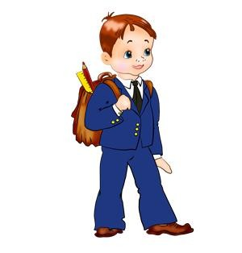

Утвердительные предложения
Ед.ч.
Мн.ч.
1 лицо
I’m a pupil.
You’re a pupil.
She’s a pupil.
He’s a pupil.
It’s a dog.
We’re pupils.
You’re pupils.
They’re pupils.
2 лицо
3 лицо

Slide 6
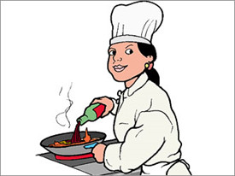
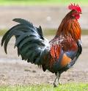
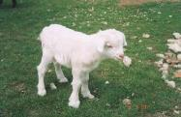
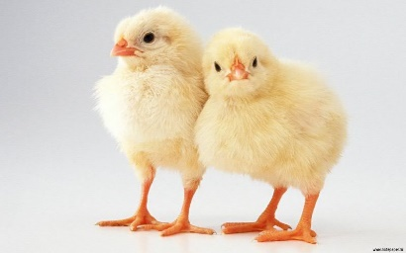


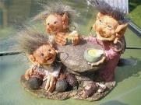

Вставь форму глагола to be - am/is/are
You … a cook.
It … a cock.
are
is
We … chicks.
It … a kid.
are
is
I … a pupil.
am
She … a queen.
is
He … a student.
They … trolls.
is
are

Slide 7

Поставь форму глагола to be - am/is/are
is
1) How old ____ your sister, Rose?
2) My father and mother ____ from Moscow.
3) I ____ a good student.
4) They ____ cold and sad.
5) ____ you twelve?
6) We ____ in London.
7) My brother and I ____ seven.
8) ____ it a cute fox?
are
am
Are
Is

Slide 8

Отрицательные предложения
Ед.ч.
Мн.ч.
1 лицо
I’m not a student.
You’re not a student.
She’s not a student.
He’s not a student.
It’s not a dog.
We’re not students.
You’re not students.
They’re not students.
2 лицо
3 лицо

Slide 9

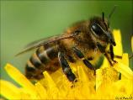

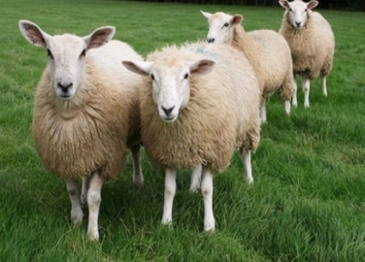

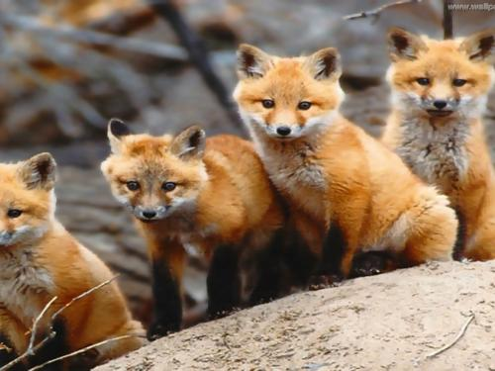
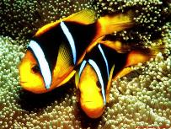
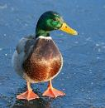
Сделай предложения отрицательными
It is an ant.
We are kids.
It is a queen.
You are a cock.
It is not an ant.
He is not a pupil.
He is a pupil.
I am a troll.
You are horses.
They are frogs.
We are not kids.
I am not a troll.
It is not a queen.
You are not horses.
You are not a cock.
They are not frogs.

Slide 10
Вопросительные предложения
Ед.ч.
Мн.ч.
1 лицо
Am I a pupil?
Are you a pupil?
Is she a pupil?
Is he a pupil?
Is it a dog?
Are we pupils?
Are you pupils?
Are they pupils?
2 лицо
3 лицо

Slide 11
Краткие ответы
Ед.ч.
Мн.ч.
1 лицо
Yes, I am/ No, I’m not.
Yes, you are/ No, you’re not.
Yes, she is/ No, she’s not.
Yes, he is/ No, he’s not.
Yes, it is/ No, it’s not.
Yes, we are/ No, we’re not.
Yes, you are/ No, you’re not.
Yes, they are/No, they’re not.
2 лицо
3 лицо

Slide 12
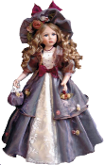

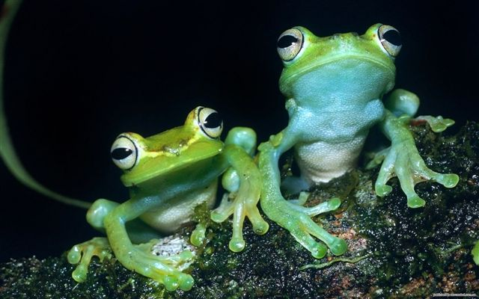

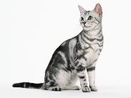
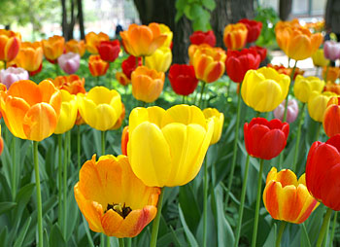
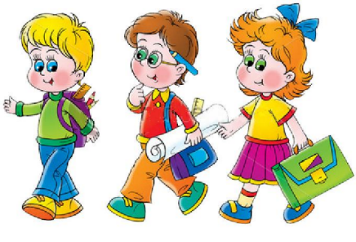
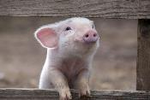
Составь вопросы
I am a cook.
He is a student.
They are tulips.
You are a pig.
She is a doll.
You are frogs.
It is a cat.
We are pupils.
Am I a cook?
Is she a doll?
Is he a student?
Are you frogs?
Are they tulips?
Is it a cat?
Are you a pig?
Are we pupils?

Slide 13

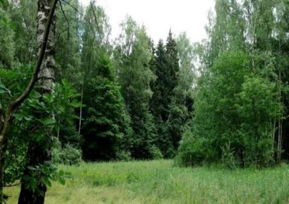
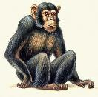

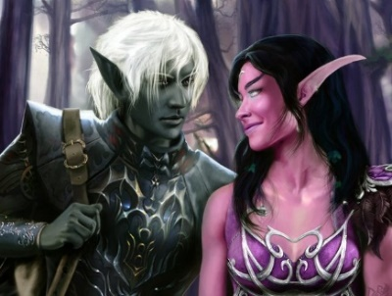
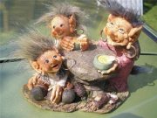
Ответь на вопросы к картинкам
No, she isn’t.
Yes, he is.
Is he a pupil?
Is it a chimp?
Is it a tulip?
Are they trolls?
Is she a cook?
Are they trees?
Are they elfs?
Is he a student?
Yes, it is.
Yes, they are.
No, it isn’t.
Yes, they are.
Yes, they are.
Yes, he is.

Slide 14
Переведи
1) Are you a student? | 5) It is not a cock.
2) We are not elfs. | 6) Is it a bus?
3) I am a pupil. | 7) You are not cooks.
4) Are they sheep? | 8) It is a duck.
Ты студент?
Это не петух.
Мы не эльфы.
Это автобус?
Я ученик.
Вы не повара.
Это овцы?
Это утка.

Slide 15
Исправь ошибки
1) You is a pupil. | 5) I not am a cook.
2) They are student. | 6) He is a chimp?
3) Are she a queen? | 7) It is box.
4) We am not trolls. | 8) Is you not pupils?
are
am not
students.
Is he
Is
a
are
Are

