Slide 1
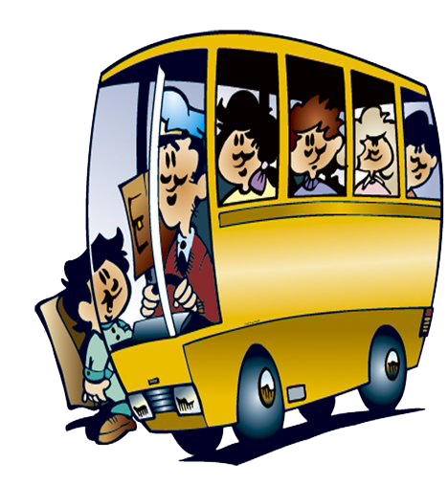
Past Simple Tense
pptcloud.ru

Slide 2

Remember!
Простое прошедшее время
(Past Simple Tense)
обозначает действия, которые произошли в прошлом

Slide 3

Remember !
Правильно говорить о том,
что действие произошло
в прошлом тебе помогут
глаголы во II форме

Slide 4
Все глаголы делятся на
правильные и неправильные
правильные
like – liked
watch – watched
play – played
count – counted
неправильные
sleep – slept
swim – swam
go – went
have – had

Slide 5

Remember!
Слова-спутники
прошедшего времени:
yesterday - вчера
the day before yesterday - позавчера
last month – в прошлом месяце
last year – в прошлом году
last week – на прошлой неделе
a year ago – год назад
a week ago – неделю назад
in 2009 – в 2009 году

Slide 6
Compare:
I go to school every day
Boys play football.
Grandma watches TV in the living room.
I went to school yesterday.
Girls played volleyball.
Mom watched a film.

Slide 7
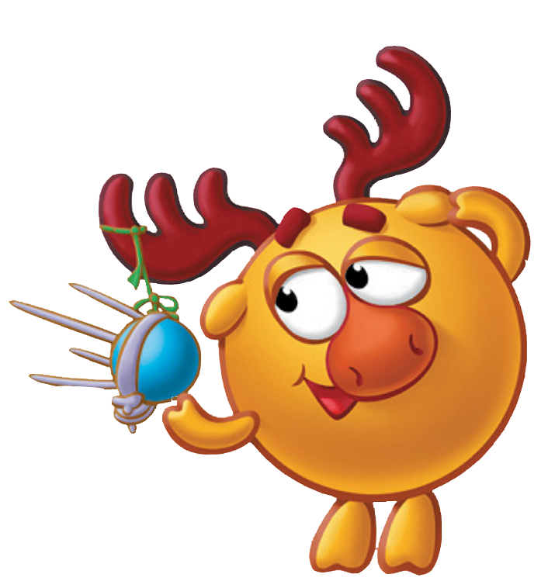
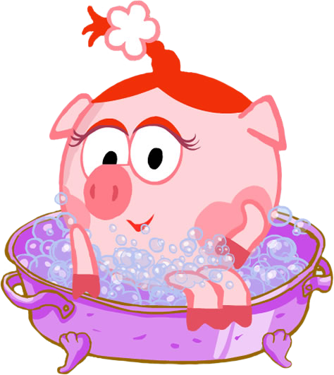
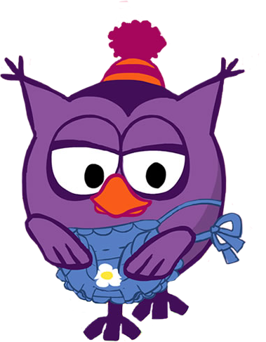

Расскажите о том,
что вы делали вчера
с друзьями

Slide 8
Remember!
Чтобы задать вопрос или составить
отрицательное предложение на помощь
приходит вспомогательный глагол
did

Slide 9
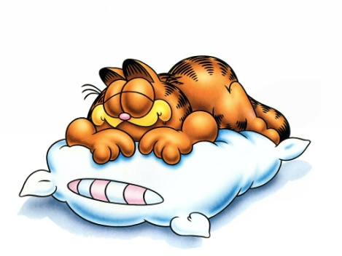
A cat
slept
yesterday.
sleep
yesterday
?
Did
a cat
did not
sleep
A cat
yesterday.

Slide 10
Задайте вопросы
My father went to the cinema yesterday.
Did my father go to the cinema yesterday?
His sister bought a new dress last week.
Did his sister buy a new dress last week?
A dog ate a bone.
Did a dog eat a bone?

Slide 11
Глагол – связка to be
1. I was
2. You were
3. He was
She was
It was
1. We were
2. You were
3. They were

Slide 12
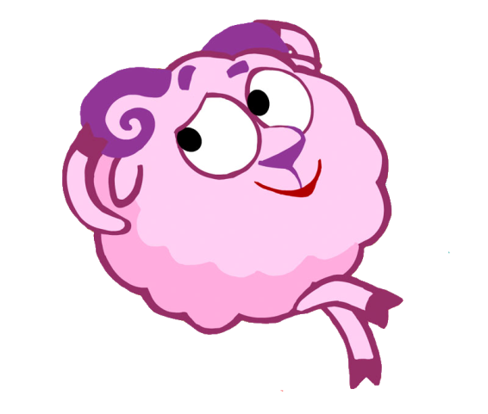

Как задать вопрос?
Was he happy?
Were they happy?

Slide 13
Отрицательные формы
was not = wasn’t
were not = weren’t

Slide 14
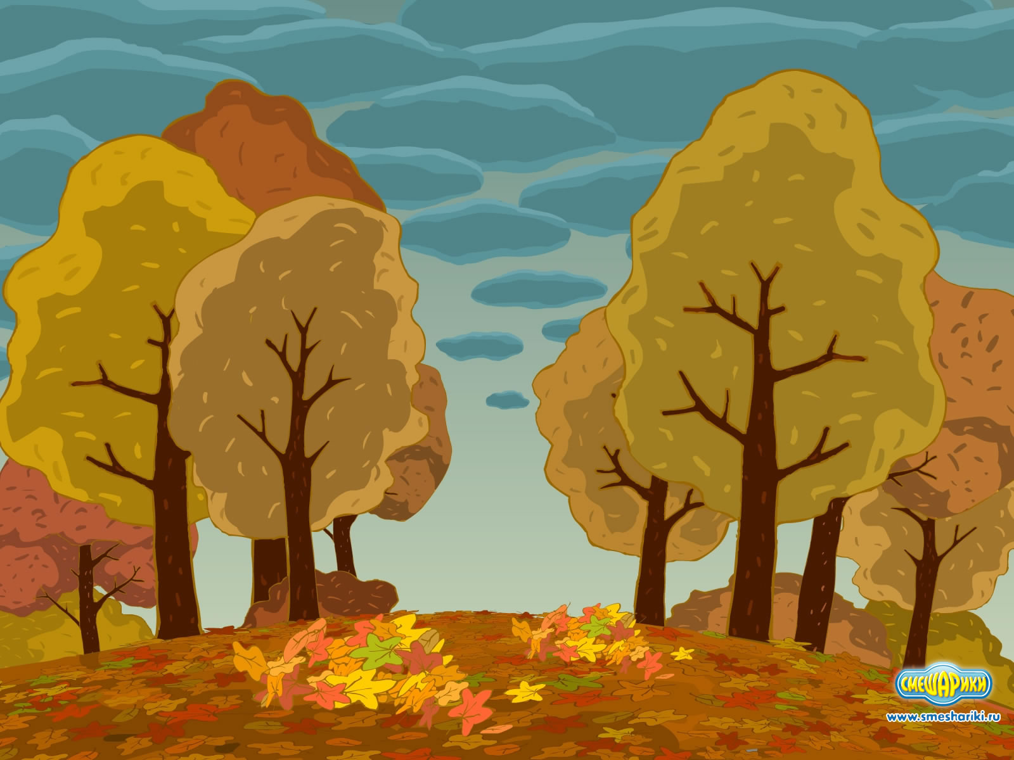
He
in the park.
was
not
We
in the park.
were
not

Slide 15
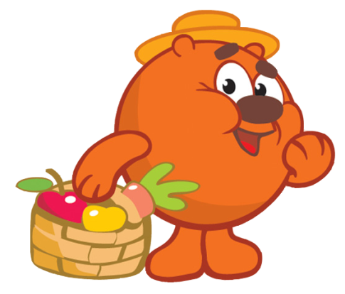
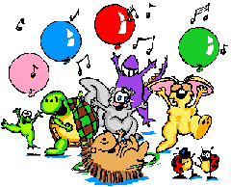
Как составить вопросительное предложение
was
happy.
?
He
were
happy.
?
They

Slide 16
Составьте вопросительные предложения
We were in the park last Sunday.
Were we in the park last Sunday?
They were very happy.
Were they very happy?
He was a very good boy.
Was he a very good boy?
I was at school yesterday.
Were you at school yesterday?

